Slide 1
A new initiative
Dr Mary Synge
Associate Professor in Law:
University of Exeter (UK)
m.k.synge@exeter.ac.uk

Slide 2
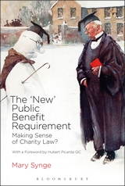

Slide 3
Arts and Humanities Research Council (AHRC)
“Research Network Scheme”
Application with Matthew Harding (Melbourne University)

Slide 4
Research Network Scheme
To support forums for the discussion and exchange of ideas on a specified subject or theme
To facilitate interaction between researchers and stakeholders
To stimulate new debate across boundaries
To identify emerging areas of intellectual urgency and potential strategic importance

Slide 5
The Scheme
£30,000 + £15,000
3 workshops over 18-24 months

Slide 6
The Scheme
£30,000 + £15,000
3 workshops over 18-24 months
Online forum
Impactful research agenda

Slide 7
Workshop 1 Melbourne: December 2019
“The boundaries of charity”

Slide 8
Workshop 2 Exeter: September 2020
“Governance, regulation and enforcement”

Slide 9
Workshop 3 Victoria, BC: July 2021
“The value of charity”

Slide 10
m.k.synge@exeter.ac.uk
Please contact me to express interest, to indicate your research area (if appropriate) and to suggest themes/questions.
Thank you.

